Slide 1
Ozmart Retail Group Cloud Migration
ICT Capstone Project Presentation
Group: 8 Unit: COIT20265
Project Mentor: Biplob Ray Term: 2024 Term 2
Students: Mohmed amaan patel (Mel)
Navdeep Saini (Mel)
Simarpreet Kaur (Mel)
Anupa Bodhimaluwa (Mel)

Slide 2
INTRODUCTION
What is Ozmart ?
Why are we migrating to cloud?
Goals of the presentation

Slide 3
Agile Methodology
Review
Plan
Design
Develop
Test
Deploy

Slide 4
Why Agile?
It is Faster
Better Communication
Continuous Feedback
Transparency
Flexible

Slide 5
There are Four main Project Phases
Initiation: define project goal, set targets, create project charter, form project team
1
Planning: create timeline, create budget, define roles and responsibilities, risk assessment, communication plan
2
Execution: Building main deliverable, regular progress review, handling issues, perform training
3
Closing: Hand over final product to customer, intensive support, perform lessons learned, released project team
4

Slide 6
Risk Assessment
Data transfer bottlenecks during migration
Data transfer bottlenecks
Firewall issues

Slide 7
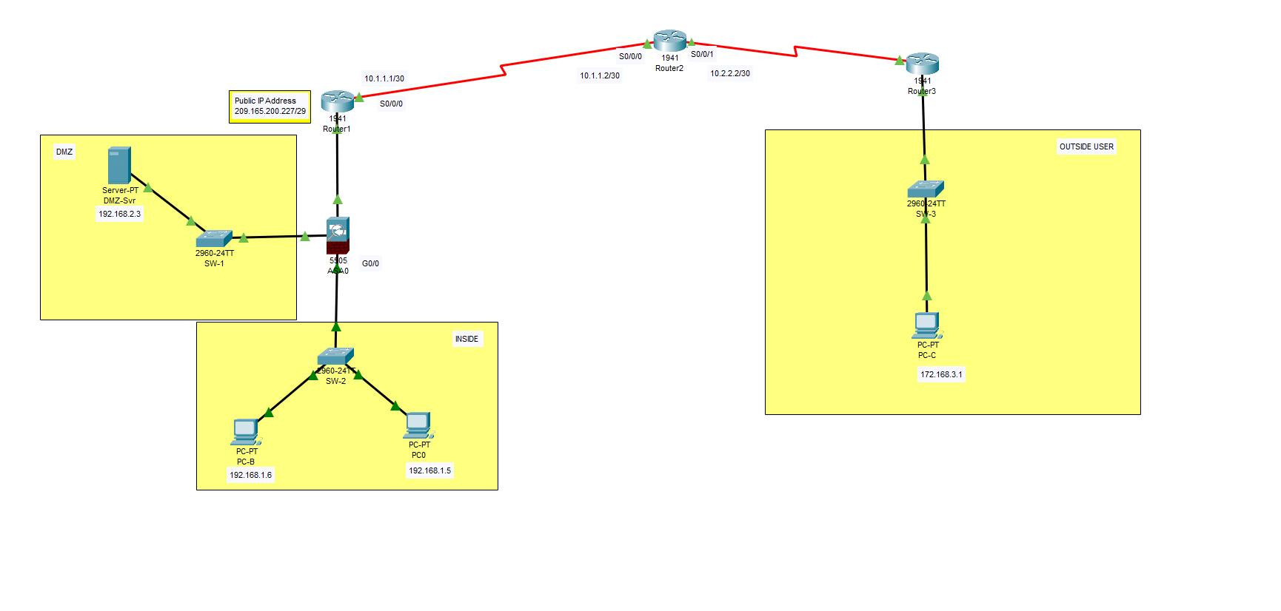
On-Premises Network

Slide 8
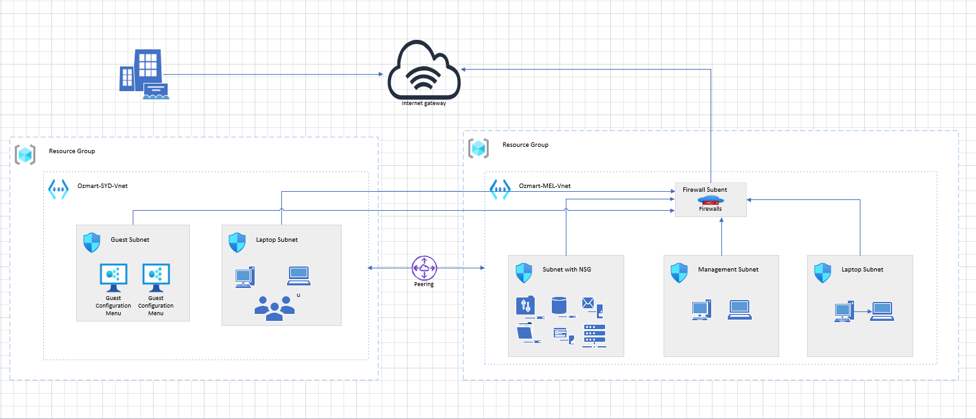
Cloud Network

Slide 9
What is cloud Migration?
Moving entire IT infrastructure, including network components, to Azure.
Benefits: Scalability, agility, global reach, and cost efficiency.

Slide 10
Why Migrate our Network To Azure?
Seamless integration with existing systems.
Flexibility to scale as need.
Increased security
Disaster Recovery

Slide 11
Migration Process overview
Assess the On-Premises infrastructure
Hybrid Connectivity
Deploying Network Components
Testing and Optimization

Slide 12
Azure Portal
Resource group
Virtual network
Virtual gateway
Azure firewall
Azure migration tool

Slide 13
Migration Tool
Azure Migration
Azure Site Recovery
Database Migration Service
Lift and shift

Slide 14
Security Reason for Moving to Azure
Cloud security
Information protection
Discover and respond
Compliance management
Insider risk management
Information governance
Identify and access management
Threat protection

Slide 15
Benefits of the NIST
Help Build Trust Among Partners
Provide comprehensive Guideline
Increases organizational Resilience
Enables integrated risk management approach
Allow flexibility

Slide 16
NIST Framework
RECOVER
IDENTIFY
PROTECT
DETECT
RESPOND
GOVERN

Slide 17
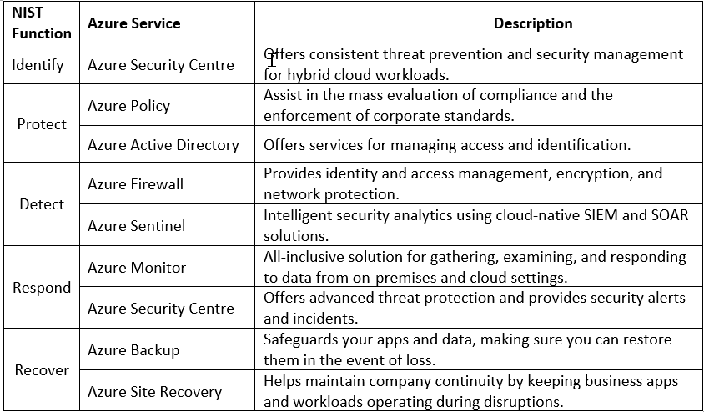
NIST Azure Implementation

Slide 18
Conclusion
Successful Migration
Benefits Realized
Challenges and Solutions
Future Opportunities

